Slide 1

HANDS-ON WITH REACT

Slide 2
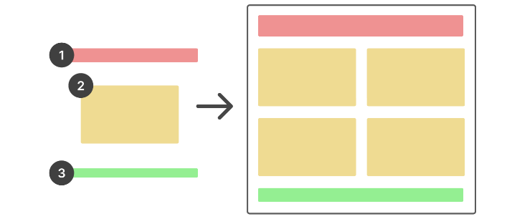
What is React?
A JavaScript library that allows you to build user interfaces (UIs) out of a hierarchy of “components”.
Widely used - Facebook, Instagram, Reddit, Twitter, Netflix, Airbnb, BBC, and many more use React for their user interfaces.
React Overview

Slide 3
Why React?
It’s approachable. Anyone with an understanding of JavaScript and HTML can pick up React.
It’s composable. Building your UI with reusable components makes your code simpler, more logical, easier to read, and less repetitive.
Creating dynamic, interactive applications becomes much easier thanks to React features like state.
Its rich ecosystem of community-created tools helps to make your life easier.
React Overview

Slide 4
Props

Slide 5
Props are React’s way of passing information to a component.
Like how an <img> tag in HTML can accept attributes like “src” and “width”, React components can accept data in the form of props.
Props are incredibly useful for creating reusable components.
React props

Slide 6
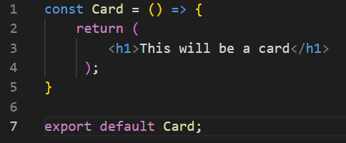
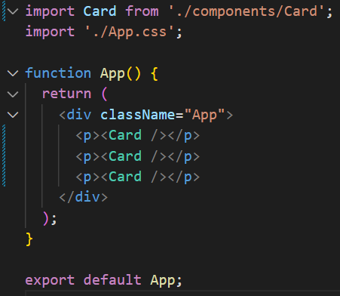
I can create a component which can be reused time and time again
React props

Slide 7
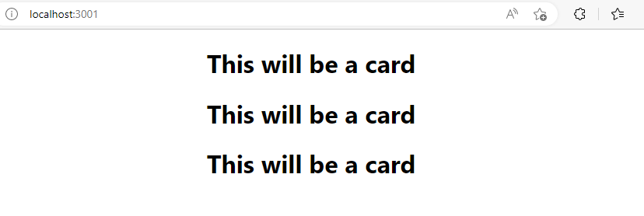
This creates a predictable output
React props

Slide 8
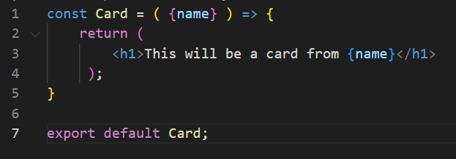
Props allow us to pass data to a child component and then have it used and re rendered based on the content we have given it.
For example, I can add a parameter to the function and then use it in the return, just like JS
This now requires information to be passed with the call. It will be deconstructed like a map
React props

Slide 9
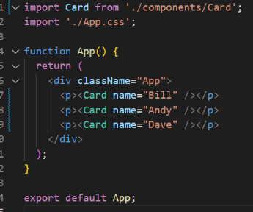
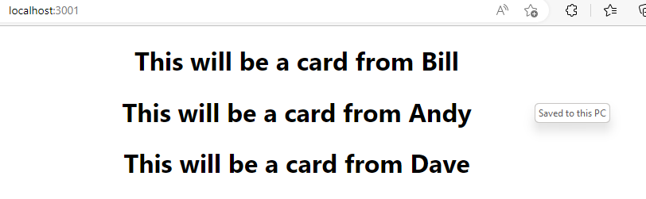
Adding this as Props to the call allow it to be returned and rendered in the App
React props
Notes:
The component is now completely reusable and will simply return the information that was passed in

Slide 10
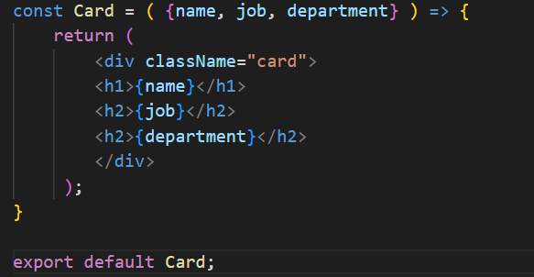
We can now change this content and pass more than one Prop to the component call.
React props
Notes:
The component is now completely reusable and will simply return the information that was passed in

Slide 11
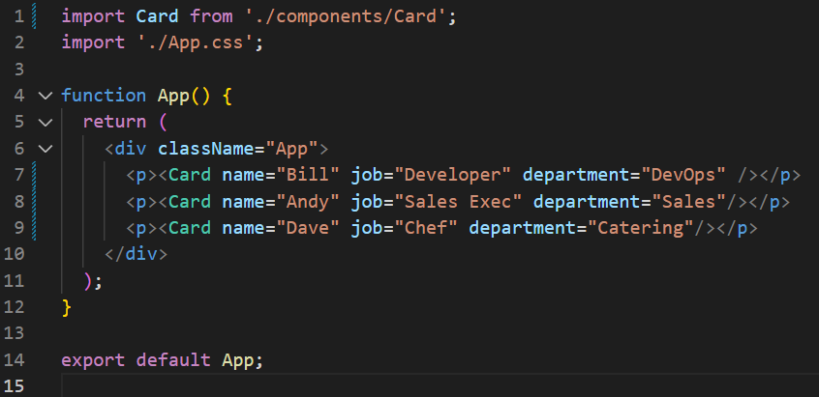
We can now change this content and pass more than one Prop to the component call.
React props
Notes:
The component is now completely reusable and will simply return the information that was passed in

Slide 12
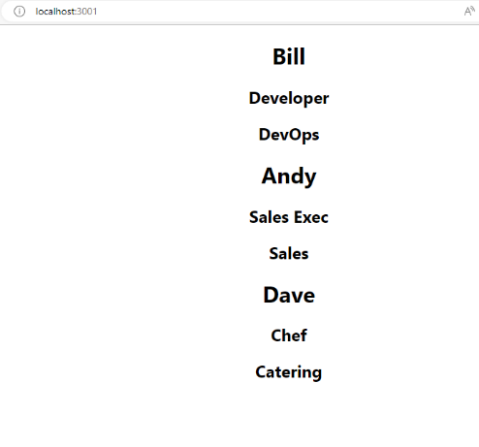
We can now change this content and pass more than one Prop to the component call.
React props
Notes:
The component is now completely reusable and will simply return the information that was passed in

Slide 13
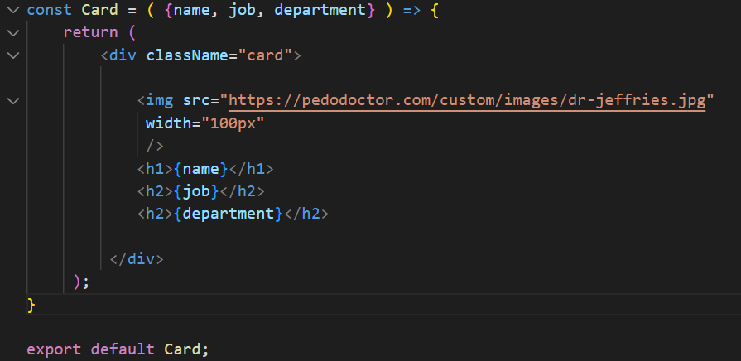
Lets add an image and edit some CSS:
React props
Notes:
Image put at the Top and the content Arranged with CSS

Slide 14
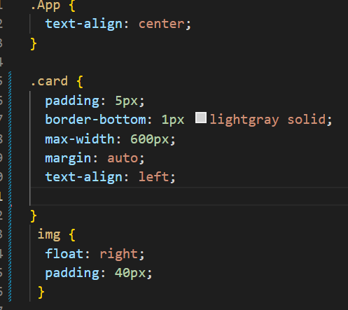
Lets add an image and edit some CSS:
App.css -
React props
Notes:
Image put at the Top and the content Arranged with CSS

Slide 15
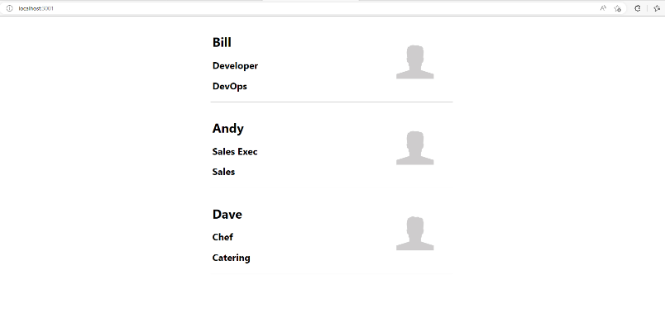
Gives us this:
React props
Notes:
Image put at the Top and the content Arranged with CSS
"https://pedodoctor.com/custom/images/dr-jeffries.jpg“ – Image source

Slide 16
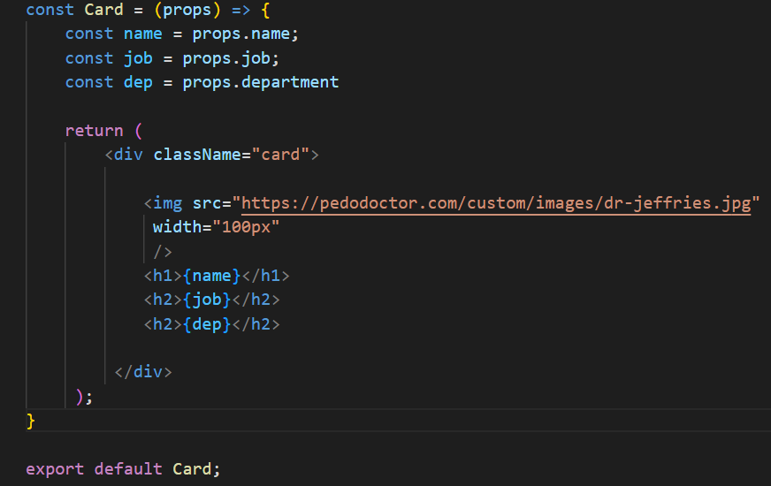
We can also pass the Props in and deconstruct them within the function itself
React props
Notes:
This is how we drag content in with arrays in react and JS. More to come on this later

Slide 17
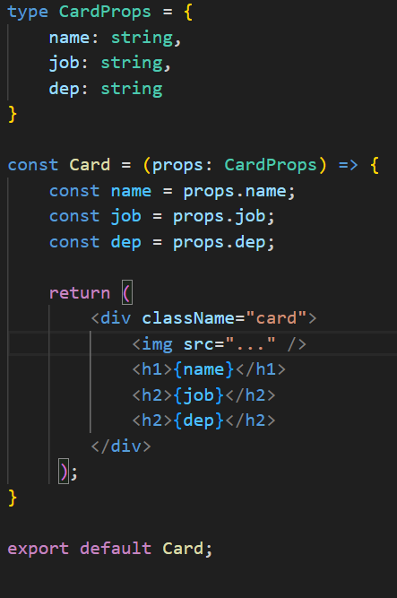
We can use TypeScript to enforce type checking on props
React props – type
checking
Notes:
Use type to create a custom type for the props. This enables intellisense when importing the component and will enforce type checking when setting props on the component.

Slide 18
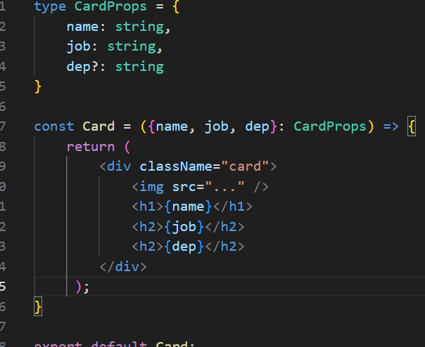
Can also destructuring to save on code.
React props – type
checking

Slide 19
QuickLab 3
Working with Props in react

